Slide 1
The Business Model Canvas
Prof. Dr. Dirk Riehle
Friedrich-Alexander University Erlangen-Nürnberg
COSS A03
Licensed under CC BY 4.0 International
Notes:
It is Friedrich-Alexander University Erlangen-Nürnberg – FAU, in short.
Corporate identity wants us to say “Friedrich-Alexander University”.

Slide 2
Business Model [1]
A business model is
  A model (description) of how an organization creates, delivers, and captures value
[1] Adapted from [OP10]

Slide 3
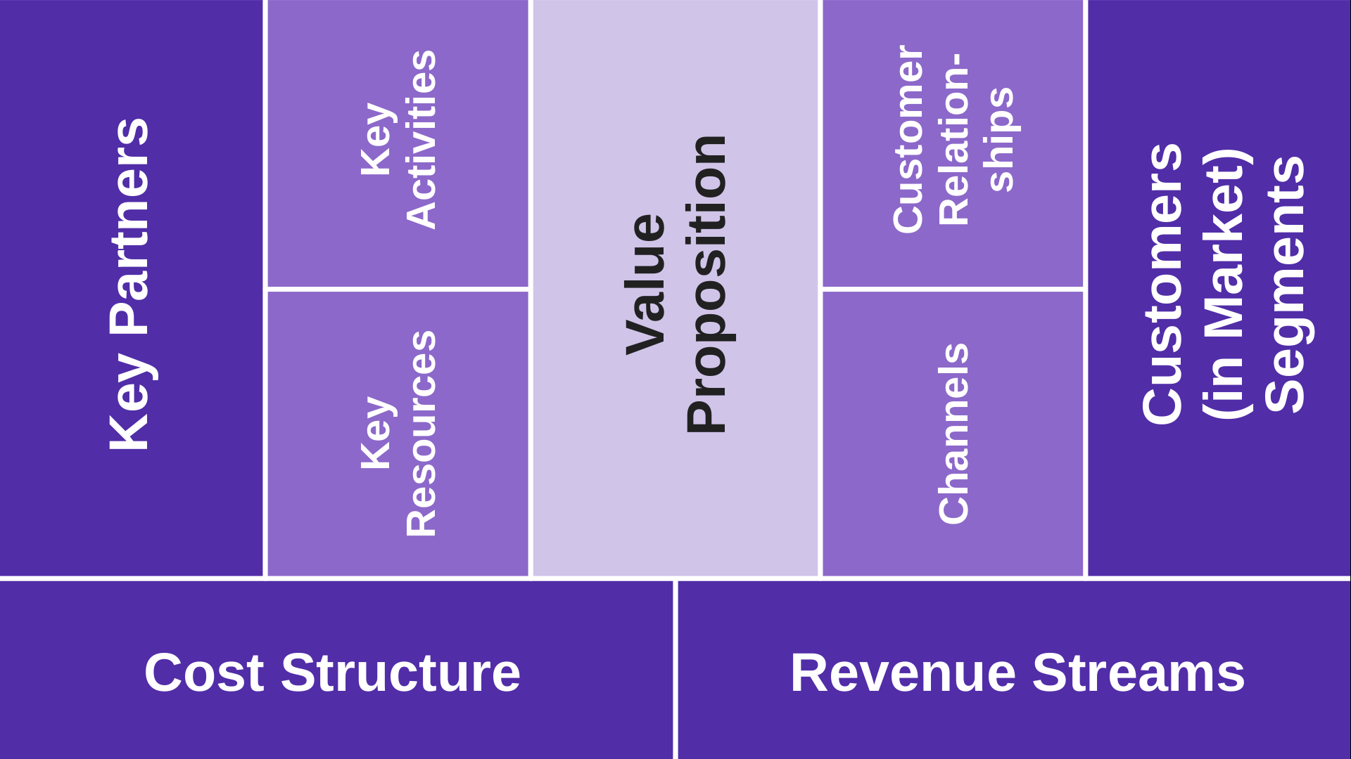
The Business Model Canvas (BMC)
Value creation
Value capture

Slide 4
2
Key
Activities
3
1
1
Customer Relationships
3
Key Partners
Customers
(in Market)
Segments
Value
Proposition
Key Re-sources
2
Channels
2
Cost Structure
Revenue Streams
3
1

Slide 5
Components of the Business Model Canvas
Customers (in market) segments
  Those the organization serves by solving their problems and fulfilling their needs and wants
Value proposition (to customers)
  The problems solved and the wants and needs satisfied
Revenue streams (from value proposition to customers)
  The income generated by successfully delivering the value propositions to customers

Slide 6
Components of the Business Model Canvas
Channels
  How the value proposition is delivered to its customers
Key partners
  The providers of key resources and key activities not owned or performed by the organization itself
Key resources
  The means (resources) necessary to instantiate and run the business model

Slide 7
Components of the Business Model Canvas
Customer relationships
  The relationship to establish and maintain with customers in market segments
Key activities
  The activities (processes and practices) necessary to operate the business model
Cost structure
  The costs and their relationships resulting from the operation of the business model

Slide 8
Thank you! Questions?
dirk.riehle@fau.de – https://oss.cs.fau.de
dirk@riehle.org – https://dirkriehle.com – @dirkriehle
DR

Slide 9
Legal Notices
License
  Licensed under the CC BY 4.0 International license
Copyright
  © 2020-2021 Dirk Riehle, some rights reserved

